Slide 1
UNIVERSITY DATABASE (sample title)
Presented by :
SUMANTH
ANUSH
SIDDHARTH
REDHA

Slide 2
Description
The database is all about the University and its operations.
The database has the details about the university, the colleges under it, the departments, the professors under each departments, the courses available and the list of students who are engaged in the courses of this university.
The database also describes about the relationship between the students, professors and the university

Slide 3
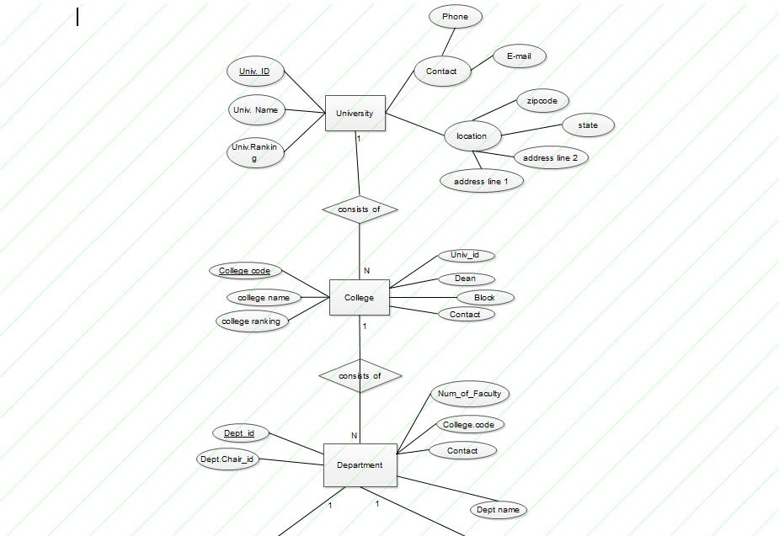
University ER Diagram

Slide 4
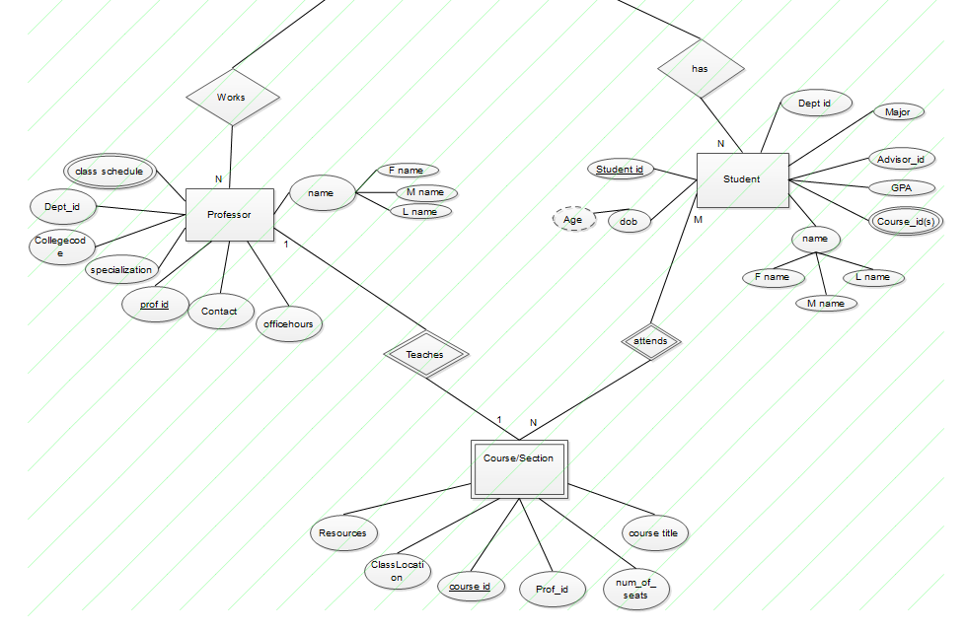
University ER Diagram

Slide 5
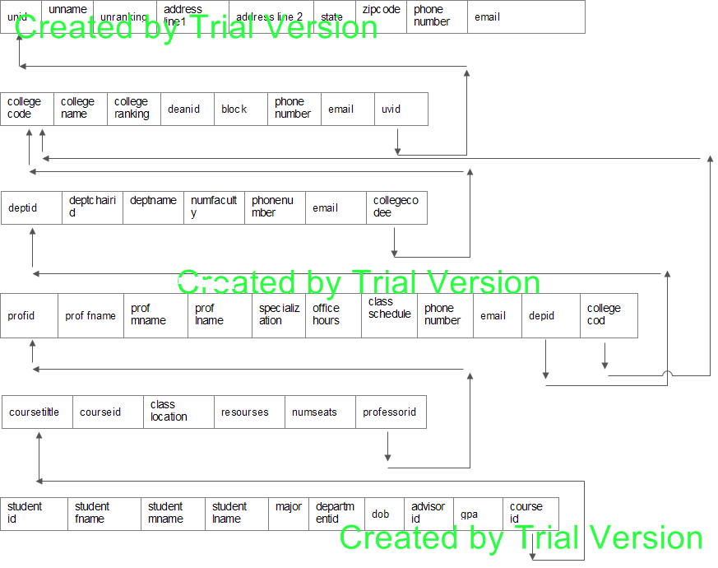
Relational Database Schema

Slide 6
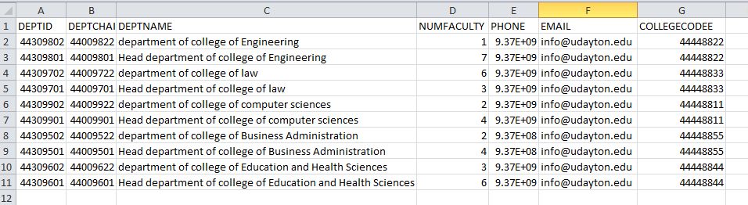
Get all departments information from University of Dayton select * from department where collegecodee in (Select collegecode from college where uvid in (Select unid from university where unname = 'university of Dayton') );

Slide 7
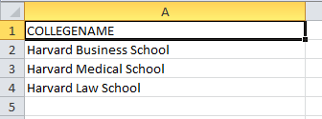
select college with ranking<5 and name starting with ‘H’;
select collegename from college where collegeranking<5 and collegename like 'H%'

Slide 8
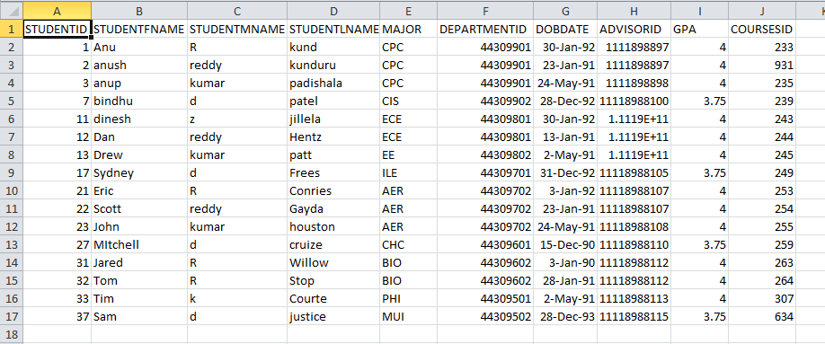
Student from university of Dayton with gpa > 3.5
Select * from student where gpa > 3.5 and departmentid in
(select deptid from department
where collegecodee in
( Select collegecode from college where uvid in
( Select unid from university where unname = 'university of Dayton' )));

Slide 9
Update prof Smith Anderson phone number update professor set phone=999999999 where proflname='Anderson' and proffname='Smith'
This Query will update the database directly by changing the phone number to 999999999 of the professor who’s first name is Smith and last name is Anderson. If the professor is not there in the database, no changes will be recorded.
delete students with the advisor id 1111898898
delete from student where advisorid= 1111898898
This Query will delete the data of all the students permanently from the database who have the advisor id as 1111898898.

Slide 10
Create a view with student details like his name and department, college and university names
CREATE VIEW student_details AS
SELECT student.studentfname,student.studentmname,student.studentlname,department.deptname,college.collegename,university.unname
FROM ((student
INNER JOIN department
ON student.departmentid=department.deptid)
INNER JOIN college
ON department.collegecodee=college.collegecode
INNER JOIN university
ON college.uvid=university.unid);

Slide 11
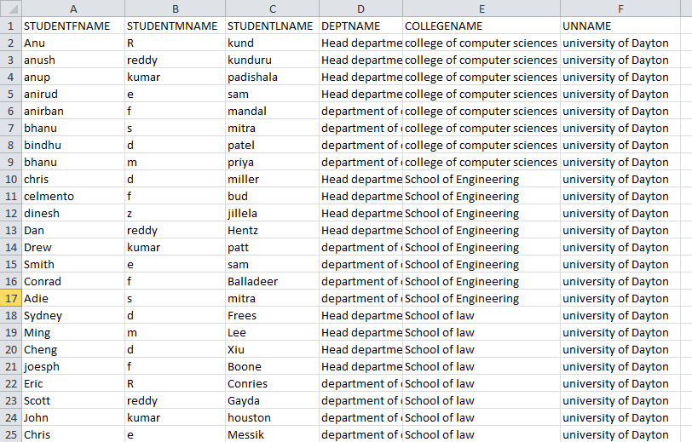

Slide 12
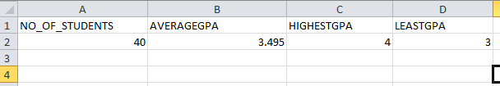
This query calculates the average gpa of all student and also shows the highest and least gpa Select count(studentid )as no_of_students, avg(gpa)as averageGPA, max(gpa) as HighestGPA, min(gpa) as LeastGPA from student

Slide 13
Any Queries on the Queries?
Thank You

